Slide 1
Verifiable e-voting What it is and what it isn’t
COMP 10001
Vanessa Teague
Dept of Computing and Information Systems
The University of Melbourne

Slide 2




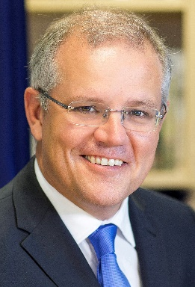



What’s wrong with this picture?
Voters
PCs
Votes via Internet
Election outcome
Electoral
Commission
server

Slide 3
End-to-end verifiability
How do you know that
Your vote is cast as you intended?
Your vote is included as cast?
All the votes are properly decrypted and tallied?
Notes:
Builds an evidence trail from cryptography
Does use paper
But not in the same way as a traditional ballot box

Slide 4
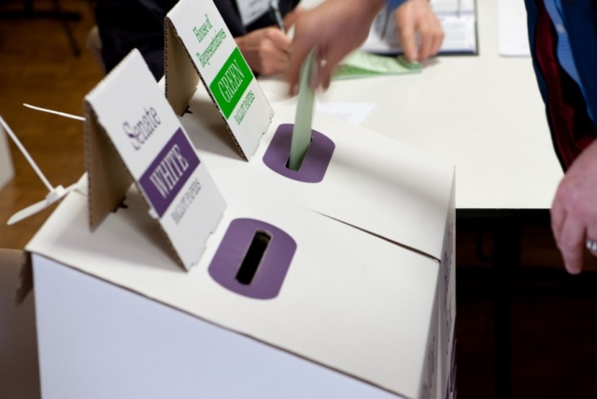
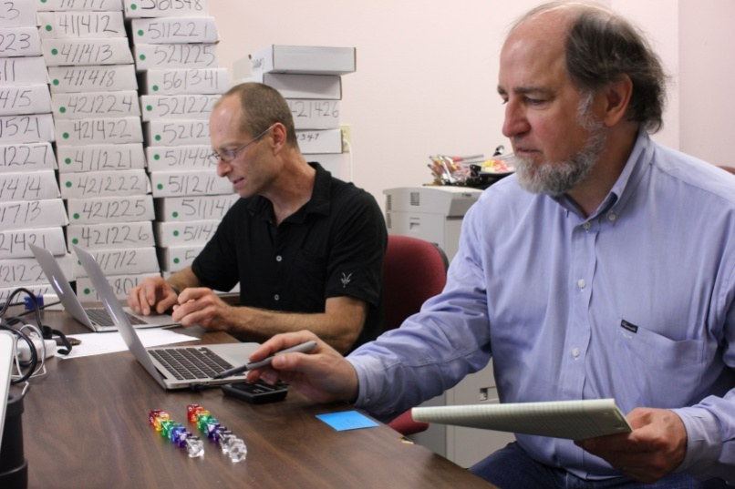
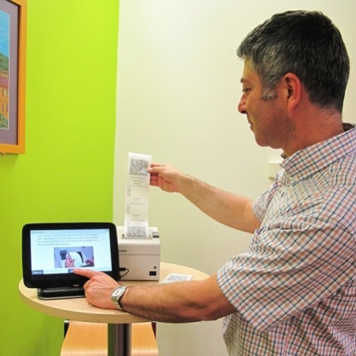
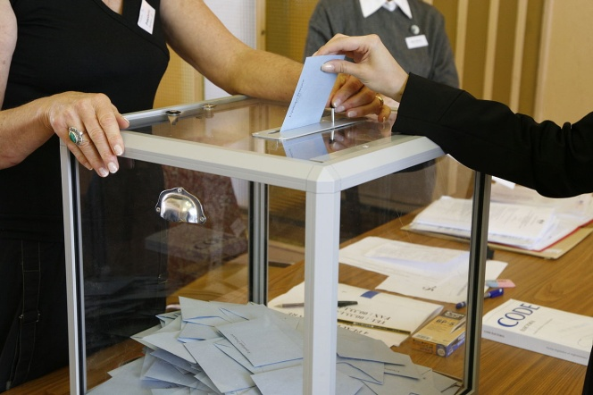
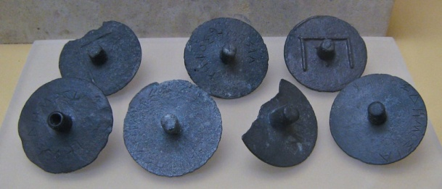
Public evidence of the right result from secret votes
Public evidence of the right result
from secret votes
The Australian ballot
Risk-limiting audits
vVote
French urne électorale
Jury voting disks
(Athenian Agora, Ca. 300 BCE)
Notes:
Australian Ballot box image from the AEC: http://www.aec.gov.au/media/image-library/files/election-signage/adelaide-2010-3.jpg reused under Creative Commons License.
French urne image by Rama: https://commons.wikimedia.org/wiki/File:Election_MG_3460.JPG reused under Creative Commons License.
Athenian voting disks image by Sharon Mollerus:
https://en.wikipedia.org/wiki/File:Athenian_Secret_Ballot.jpg reused under Creative Commons License
Risk Limiting Audits by Philip Stark and Ron Rivest, reproduced from Ars Technica with permission. http://arstechnica.com/tech-policy/2012/07/saving-american-elections-with-10-sided-dice-one-stats-profs-quest/

Slide 5

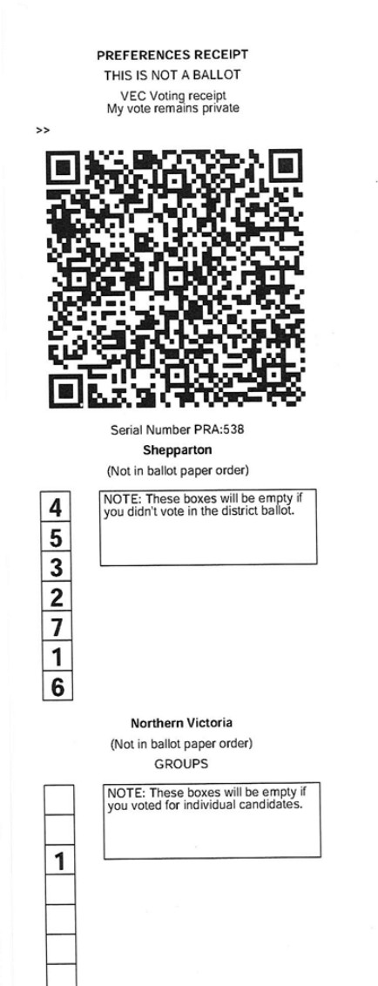
Victorian vVote: end-to-end verifiable pollsite electronic voting
Vic State Election 2014 1121 votes
From supervised polling places in London and Vic
Voters take home a copy of their vote (encrypted)
Notes:
Photo: Prof Steve Schneider, U Surrey. http://www.surrey.ac.uk/features/new-advanced-e-voting-system-selected-australian-state-election Reproduced with permission.

Slide 6


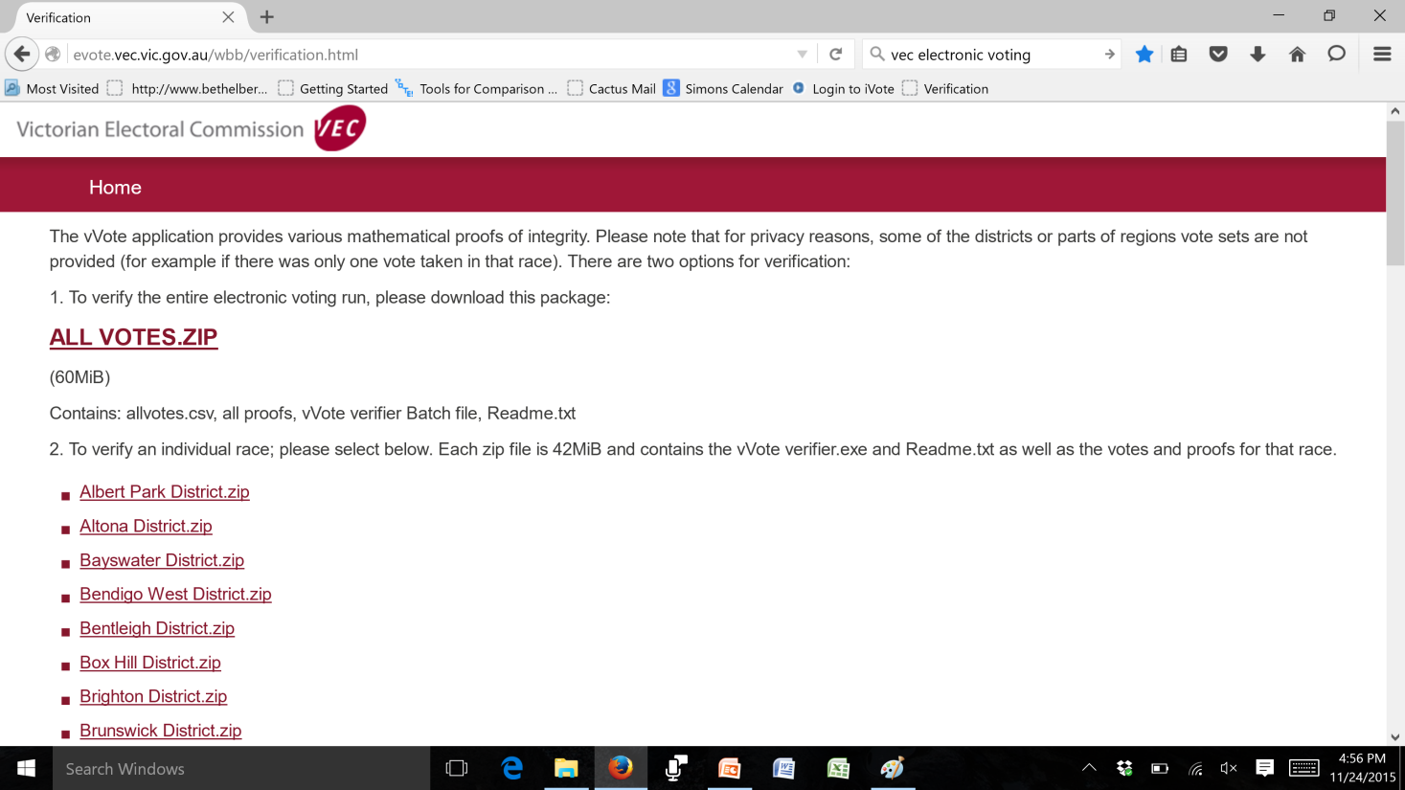
Vic State Election 2014 1121 votes from supervised polling places
Vic vVote
Electoral Commission
Vote Server
Vote; Receipt
Notes:
6
Voters’ guide to verification: http://electionwatch.edu.au/victoria-2014/click-here-democracy-e-vote-explained
Technical Report: http://arxiv.org/abs/1404.6822
Source Code: https://bitbucket.org/vvote/
Verification Data: http://evote.vec.vic.gov.au/wbb/verification.html

Slide 7
NSW iVote
Individual vote verification described here:
https://www.elections.nsw.gov.au/Voters/Other-voting-options/
iVote-online-and-telephone-voting
You vote online, then you use a (closed-source) app from the
Same company to check your vote.

Slide 8


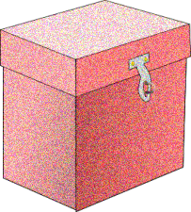

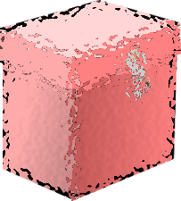

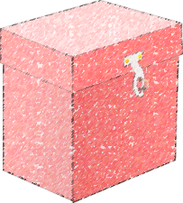
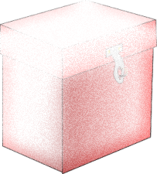
Shuffle proof (vVote, SwissPost, and apparently iVote too)
Mix servers shuffle and rerandomize
Prove at each step that the set of votes hasn’t changed
In from voters
Out to tally
Notes:
Jakobsson, Markus, Ari Juels, and Ronald L. Rivest. "Making Mix Nets Robust For Electronic Voting By Randomized Partial Checking." USENIX security symposium. 2002.

Slide 9
What if the shuffle proof has a logical flaw too?
https://people.eng.unimelb.edu.au/vjteague/SwissVote
https://www.itnews.com.au/news/nsw-electoral-commission-confirms-ivote-contains-critical-scytl-crypto-defect-520460
https://www.computerworld.com.au/article/658709/nsw-ivote-could-face-renewed-scrutiny-after-swiss-svote-flaw-revealed/

Slide 10
And now for some maths
Think of a very large prime number p
At least 2048 bits long (600 decimal digits)
And a (smaller) number g
Think of a very large secret x
Publish g,p, and h = g^{x} mod p
mod just means take the remainder after division
This is your public key
Keep x secret
This is your private key.
Assumption: Given g,p,h, it’s not feasible to compute x.
This is the “discrete log assumption”

Slide 11
So what was wrong with the shuffle proof?
There were some numbers
Call them g, h,
The proof was proven secure under the discrete log assumption
But there was no proof that somebody didn’t just make up an x and compute
h = g^x.
If a mixer knew x, it could produce a “proof” that passed verification but manipulated votes

